Slide 1



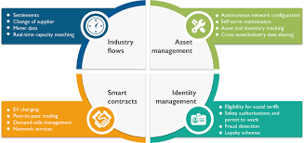

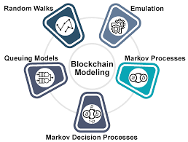


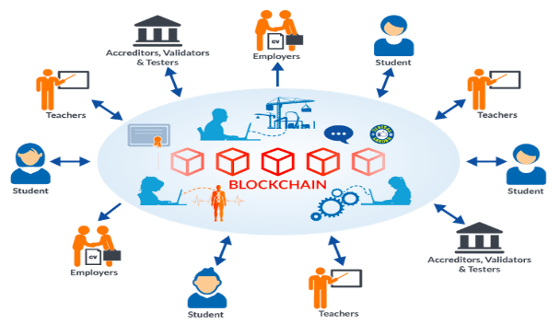

Crypto Currency With Block Chain Technology
Student Name: Raj Kumar Bhukya
Student Code: W9598301
Research purpose
Research Methodology
Evaluation methodology
Researchers from diverse professions have been drawn to cryptocurrency and blockchain technologies in recent years due to its rapid rise in popularity and recognition. Numerous research projects aiming at comprehending and utilizing this technology's capabilities have been stimulated by its prospective uses and implications.At present, it is seen in the UK that healthcare professionals have faced issues while providing health-based treatment.
Research question
1.What are the results for financial institutions and how do cryptocurrencies affect the established financial system?
Research Design: A mix of quantitative and qualitative research approaches is used in this study. To give a thorough examination of the subject, it includes gathering both quantitative data and qualitative insights.
Querying the Literature
The following research issues serve as its guidelines:
What major factors and obstacles are preventing the widespread use of cryptocurrencies and blockchain technology in various industries?
b. What effects do legal frameworks have on the expansion and creation of blockchain and cryptocurrency applications?
c. How may blockchain technology be used in non-cryptocurrency contexts and what advantages does it offer?
d. In what ways do businesses view the security, scalability, and interoperability issues brought on by blockchain technology?
Clearly identify the evaluation's aims, such as gauging the effectiveness of blockchain-based transactions, gauging the security of digital wallets, or examining the effects of DeFi (decentralised finance) applications.
These goals provide the precise measures to be monitored and direct the review process.
Determine the pertinent measurements that support the evaluation objectives before choosing your evaluation metrics.
Transaction speed, scalability, security features, cost-effectiveness, user acceptance rates, degree of centralization, energy use, or regulatory compliance are a few examples of these indicators.
Quantitative data should be gathered from a variety of sources, such as smart contracts, blockchain networks, transaction logs, and performance benchmarks. Through APIs, network monitoring tools, and other methods, this information
Background context
The disruptive breakthroughs of cryptocurrency and blockchain technology have the potential to revolutionize several industries, including finance, supply chain management, healthcare, and more.
The underlying ideas and principles that guide cryptocurrency and blockchain technology's operation and the causes promoting their wide acceptance are the focal points of the background context surrounding these technologies.
The capacity of blockchain technology to establish a transparent ledger is one of its fundamental characteristics.
Schedule and dissemination plans
Activities | Start date | End date | Duration
Selection of topic | 20-04-2023 | 25-04-2023 | 5
Setting aims and objectives | 26-04-2023 | 06-05-2023 | 10
Literature review | 07-05-2023 | 22-05-2023 | 15
Research Methodology | 23-05-2023 | 12-06-2023 | 20
Data collection | 13-06-2023 | 25-06-2023 | 12
Data analysis | 26-06-2023 | 06-07-2023 | 10
Ethical consideration | 07-07-2023 | 19-07-2023 | 12
Final submission | 20-07-2023 | 28-07-2023 | 8
Reference List
Brunier, A. and Drysdale, C., (2020). COVID-19 is disrupting mental health services in most countries WHO survey. World Health Organization, pp.2021-06. https://friends-project.eu/media/who_int_news_item_05_10_2020_covid_19_disrupting_mental_health_services_in_most_countries_who_survey.pdf
Chen, M. and Decary, M., (2020), January. Artificial intelligence in healthcare: An essential guide for health leaders. In Healthcare management forum (Vol. 33, No. 1, pp. 10-18). Sage CA: Los Angeles, CA: SAGE Publications. https://journals.sagepub.com/doi/pdf/10.1177/0840470419873123
Gopal, G., Suter-Crazzolara, C., Toldo, L. and Eberhardt, W., (2019). Digital transformation in healthcare–architectures of present and future information technologies. Clinical Chemistry and Laboratory Medicine (CCLM), 57(3), pp.328-335. https://www.degruyter.com/document/doi/10.1515/cclm-2018-0658/html?lang=de
Greenberg, N. and Tracy, D. (2020). What healthcare leaders need to do to protect the psychological well-being of frontline staff in the COVID-19 pandemic. Bmj Leader. https://www.ncbi.nlm.nih.gov/pmc/articles/PMC7192780/
Maddox, B.B., Crabbe, S., Beidas, R.S., Brookman-Frazee, L., Cannuscio, C.C., Miller, J.S., Nicolaidis, C. and Mandell, D.S., (2020). “I wouldn’t know where to start”: Perspectives from clinicians, agency leaders, and autistic adults on improving community mental health services for autistic adults. Autism, 24(4), pp.919-930. https://www.ncbi.nlm.nih.gov/pmc/articles/PMC7192780/
Moroz, N., Moroz, I. and D’Angelo, M.S., (2020), November. Mental health services in Canada: barriers and cost-effective solutions to increase access. In Healthcare management forum (Vol. 33, No. 6, pp. 282-287). Sage CA: Los Angeles, CA: SAGE Publications. https://journals.sagepub.com/doi/pdf/10.1177/0840470420933911
Odendaal, W.A., Watkins, J.A., Leon, N., Goudge, J., Griffiths, F., Tomlinson, M. and Daniels, K., (2020). Health workers’ perceptions and experiences of using mHealth technologies to deliver primary healthcare services: a qualitative evidence synthesis. Cochrane Database of Systematic Reviews, (3). https://scholar.google.com/scholar?output=instlink&q=info:cs6UV4M847kJ:scholar.google.com/&hl=en&as_sdt=0,5&as_ylo=2019&scillfp=2429973520005351929&oi=lle
Singh, D.R., Sunuwar, D.R., Shah, S.K., Karki, K., Sah, L.K., Adhikari, B. and Sah, R.K., (2021). Impact of COVID-19 on health services utilisation in Province-2 of Nepal: a qualitative study among community members and stakeholders. BMC health services research, 21(1), pp.1-14. https://bmchealthservres.biomedcentral.com/articles/10.1186/s12913-021-06176-y
Tanhan, A., Yavuz, K.F., Young, J.S., Nalbant, A., Arslan, G., Yildirim, M., Ulusoy, S., Genç, E., Ugur, E. and Çiçek, İ., (2020). A proposed framework based on a literature review of online contextual mental health services to enhance well-being and address psychopathology during COVID-19. https://acikerisim.sakarya.edu.tr/xmlui/bitstream/handle/20.500.12619/95221/10.29333%20ejgm%208316.pdf?sequence=1&isAllowed=y
Professional, legal and ethical issues
The disruptive developments of cryptocurrencies and blockchain technology have the potential to assist a number of industries, including finance, supply chain management, healthcare, and others. Bitcoin, Ethereum, and Litecoin are examples of digital or virtual currencies that depend on cryptography for secure and decentralised transactions. In contrast to traditional fiat currencies that are issued and administered by central banks, cryptocurrencies operate on decentralised networks, frequently based on blockchain technology.
To avoid unintentionally compromising any patient's privacy, data privacy and confidentiality must be respected. The fact that no laws, regulations, or even public property should be harmed in any way must be emphasised..
conclusion
Finally, blockchain technology has completely changed the cryptocurrency industry. Blockchain has given the creation and trade of digital currencies a secure platform thanks to its decentralised and transparent nature. Cryptocurrencies are now widely used and accepted, disrupting established financial systems and giving people more control over their possessions. Blockchain technology provides enormous potential for additional innovation and revolution in other industries outside of banking, laying the path for a decentralised future as it continues to advance.

